Slide 1


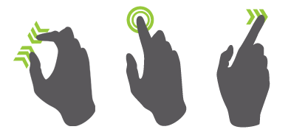
Gesture Detection Robot
Indira Gandhi Delhi Technical University for Women
Team Members:
Asmita Bhardwaj
Sakshi Sharma
Shrutika

Slide 2

Gestures are the most basic features of a living being So machine controlled by gestures is the most promising technology to look out for. Building up on this idea we have designed a car controlled by the motion of our hand.

Slide 3
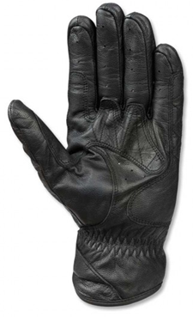
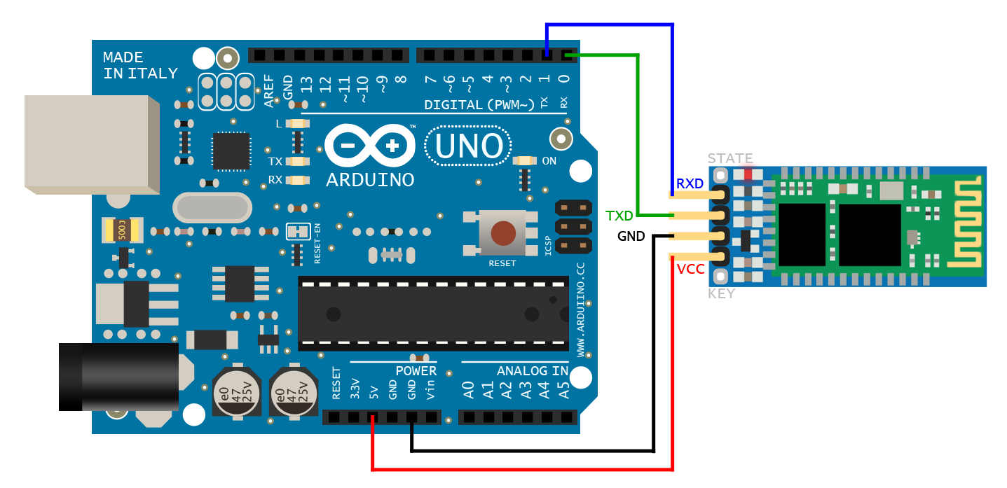
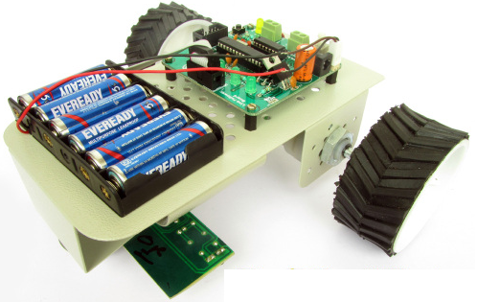
The Gestures made by the hand are tracked using an Arduino and commands are accordingly sent to the RoboCar using the Master Bluetooth Module
The commands sent by Master Bluetooth Module are received by the Slave Bluetooth Module and are further communicated to the Arduino controlling the Robocar

Slide 4
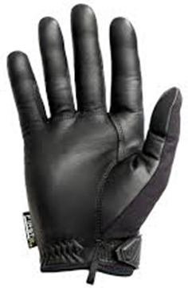
Circuit Of Glove
The Glove is provided with the metallic contacts which when come in contact send the input to Arduino which then accordingly sends the command to the RoboCar using Master Bluetooth Module

Slide 5
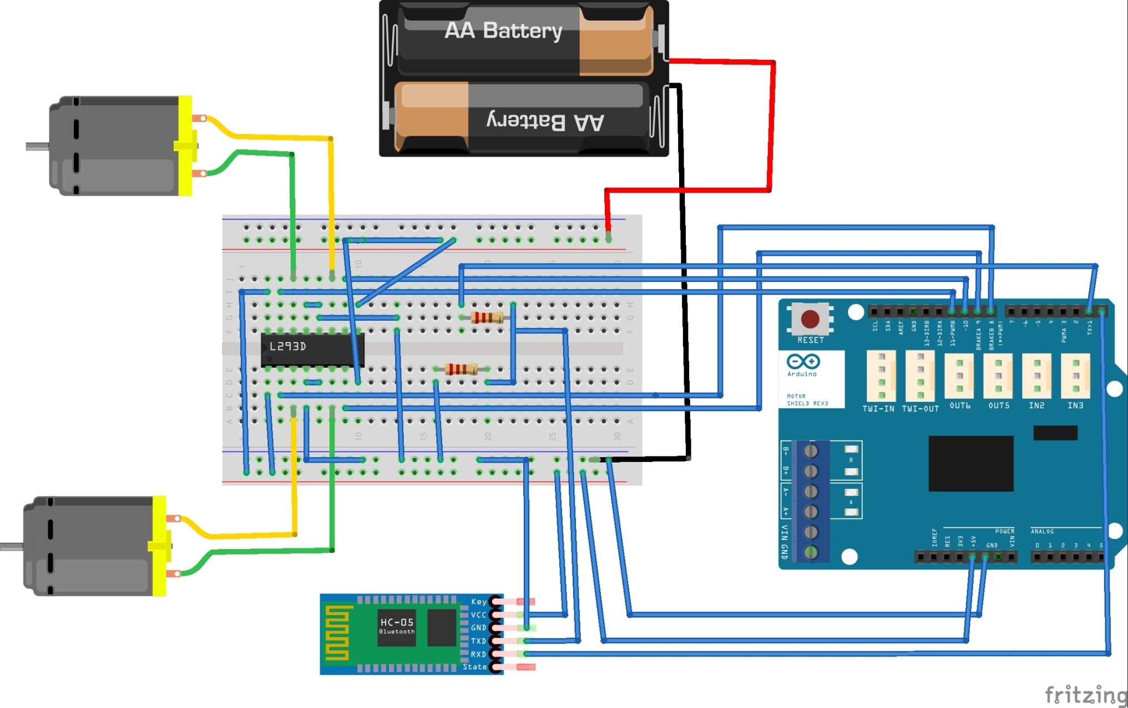
Circuit Of The RoboCar

Slide 6
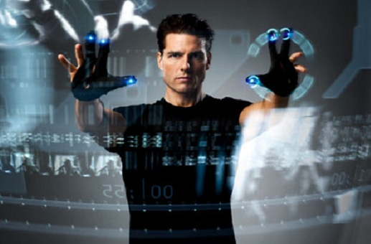
Future Aspects

Slide 7
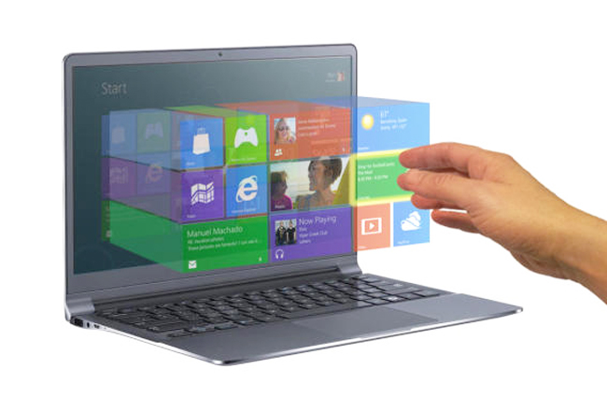
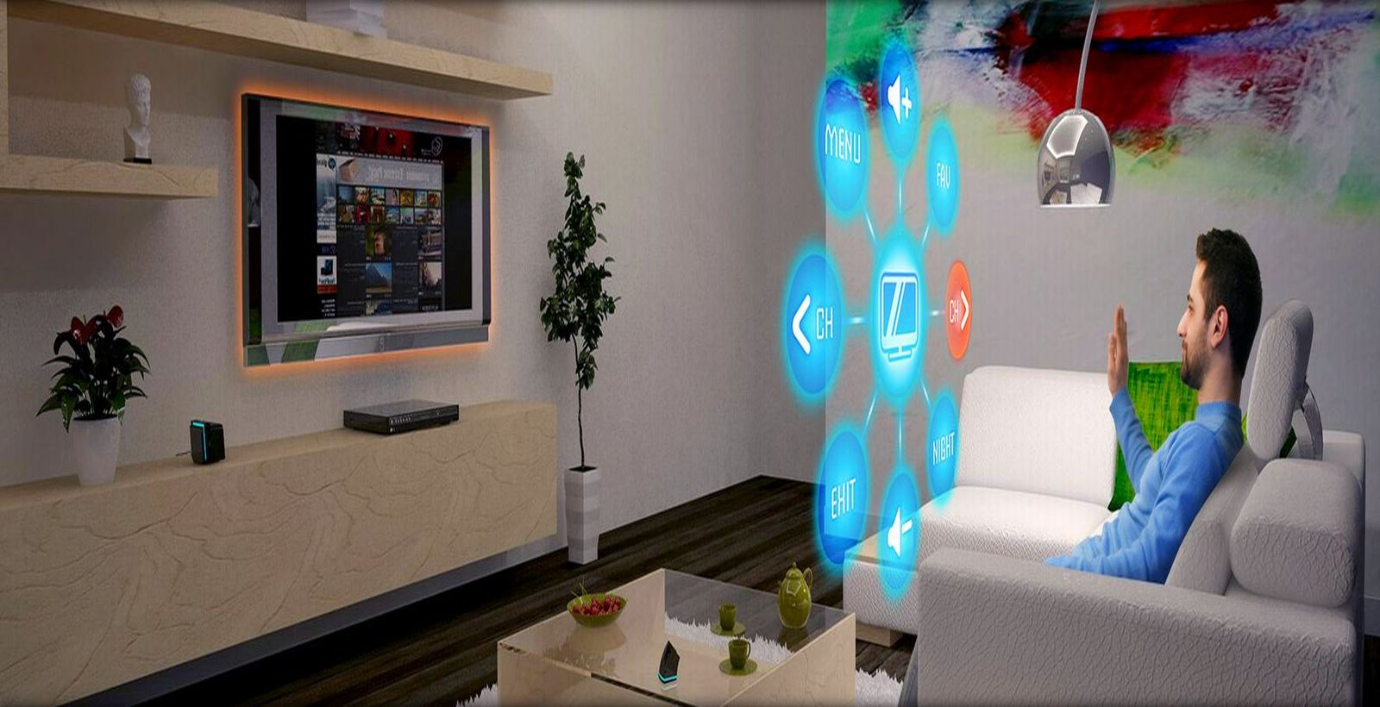

Control the Virtual World With Gestures

Slide 8
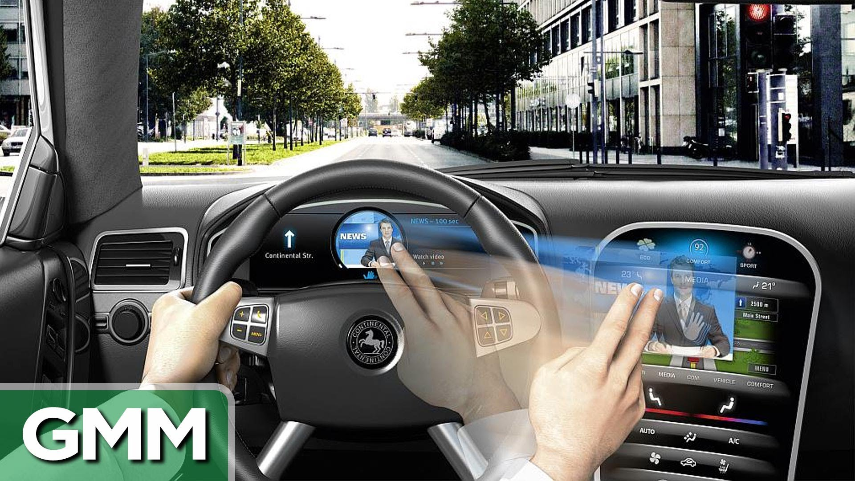
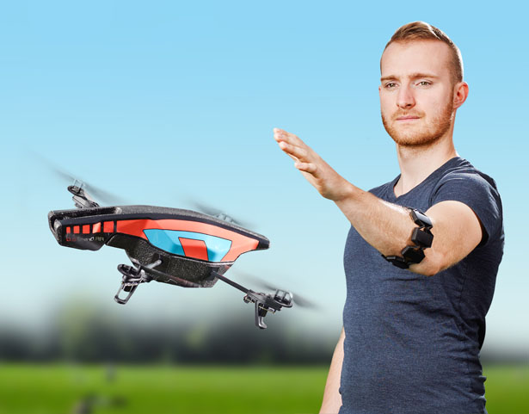
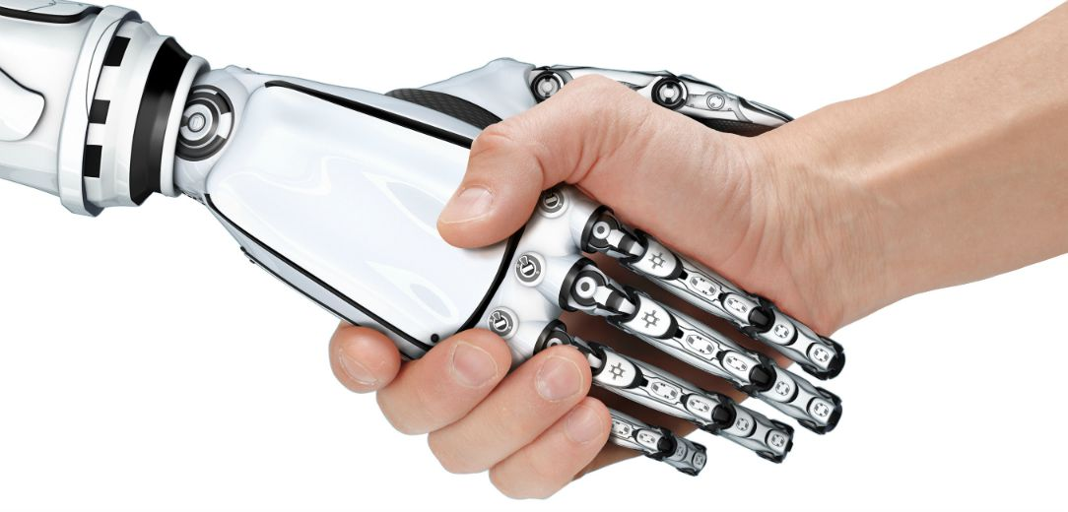
Control the Real World Entities using Gestures

Slide 9

Our thoughts are the only limit..

